Slide 1
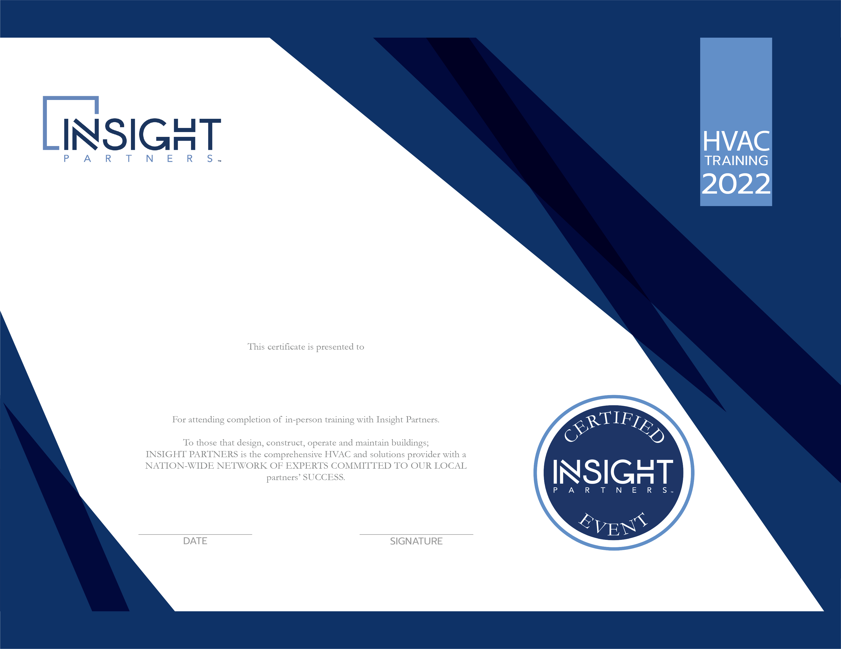
Filtration Methods for Cleaning Water in HVAC Systems
Customers Name Here
12.15.22
David Romeo

